Slide 1
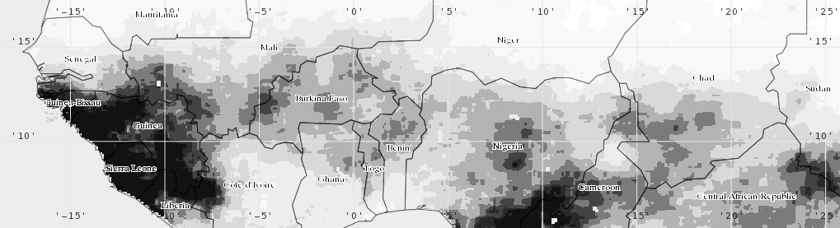
VIC DATA INPUTS AND OPTIONAL PROCESSES
Kel Markert
NASA-SERVIR Mekong Regional Associate
University of Alabama in Huntsville | Earth System Science Center
6 March 2017

Slide 2
VIC MODEL INPUTS
The VIC model is complex requiring large amount of data in stored in multiple files
Much of the data can be acquired from remote sensing/GIS data sets
Soil Parameters
Vegetation Parameters
Global Parameters
VIC Model
Vegetation Library
Meteorological Forcing

Slide 3
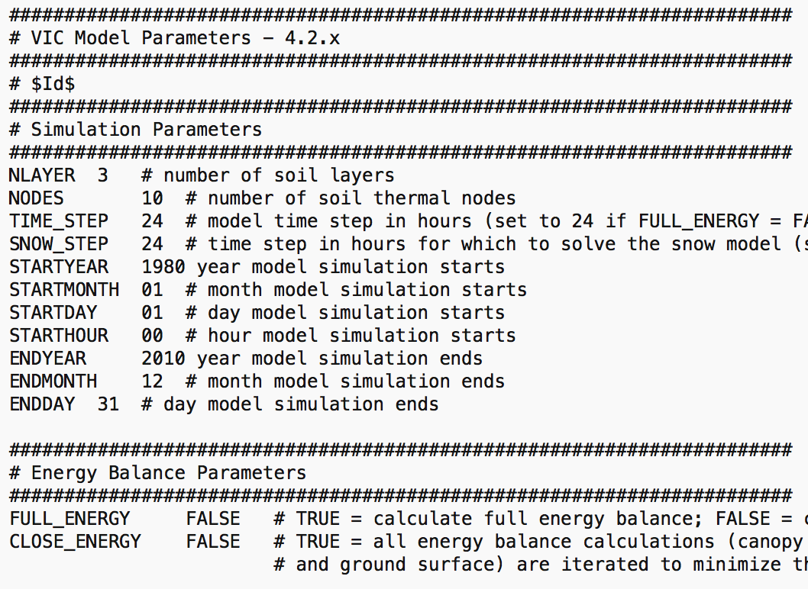
GLOBAL PARAMETER FILE
Main input file for VIC
Sets some model parameters and options
Points VIC to the locations of other input/output file
Sets parameters that govern the simulation
Start/end dates
Model modes
Physical processes
Global parameter file documentation: http://vic.readthedocs.io/en/master/Documentation/Drivers/Classic/GlobalParam/

Slide 4
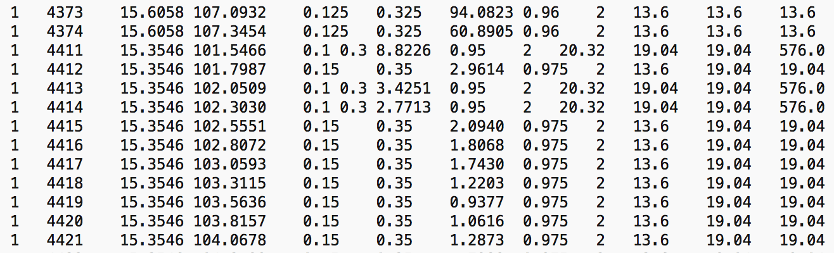
SOIL PARAMETER FILE
Defines the spatial representation of the model
Grid cell ID
Latitude/longitude
Model links the rest of data inputs through soil file by using grid cell ID
Defines soil parameters at surface and each depth
Defines initial soil moisture conditions when no state file is used
Soil parameter file documentation: http://vic.readthedocs.io/en/master/Documentation/Drivers/Classic/SoilParam/
Run value
Grid cell ID
Lat/Lon
Soil parameters

Slide 5
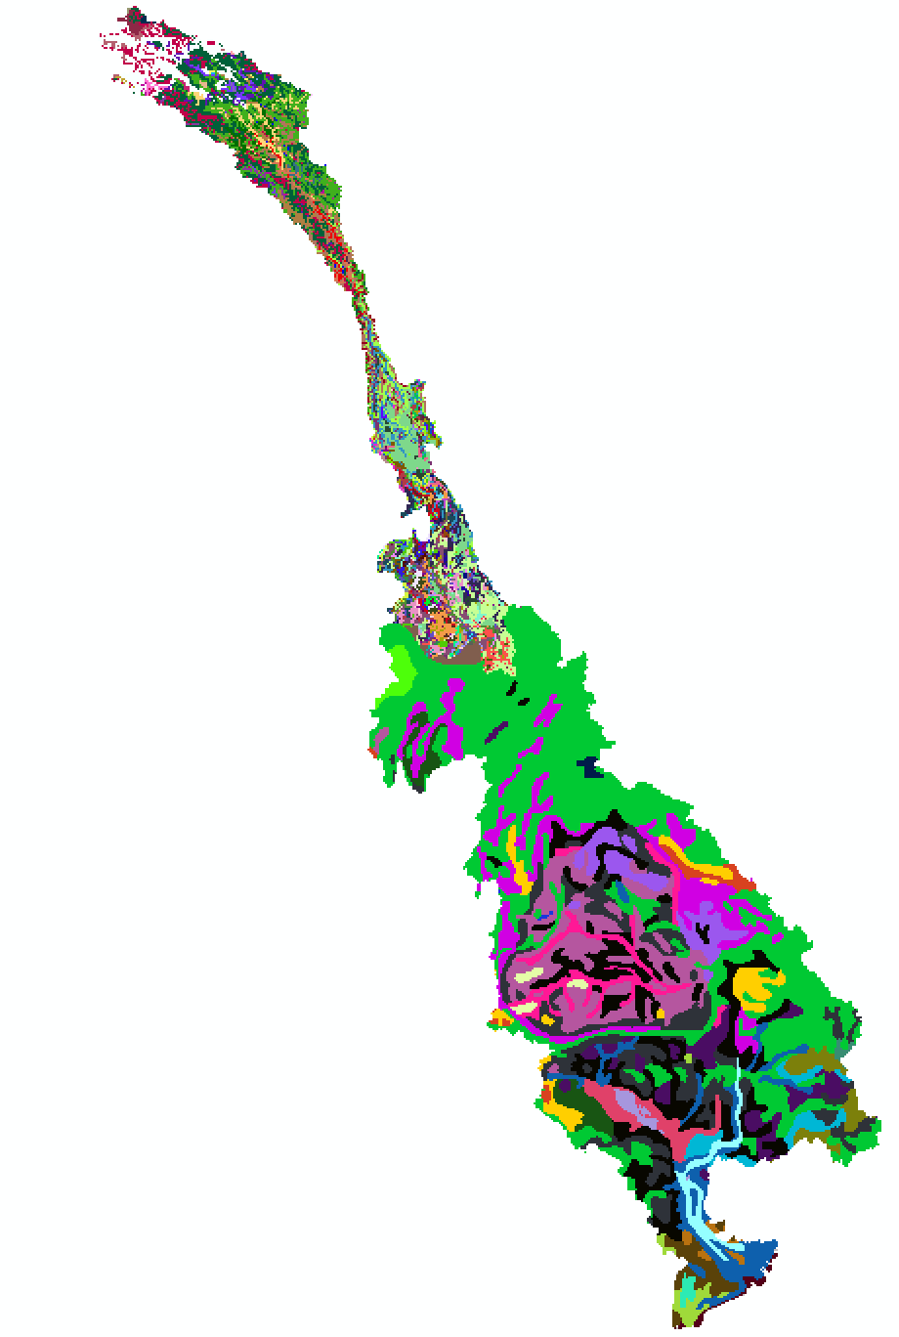
SOIL DATA
Soil information is poorly know
Harmonized World Soil Database (HWSD)
30 arc-second (~1km) raster database
Classified raster grid with database look-up information
http://www.fao.org/soils-portal/soil-survey/soil-maps-and-databases/harmonized-world-soil-database-v12/en/
Contains over 15,000 different soil mapping units
Has multiple soil parameters per mapping unit
Used for soil pedotransfer functions
Accuracy and mapping information differs by region
Example: Lower vs Upper Mekong
Region data differences

Slide 6
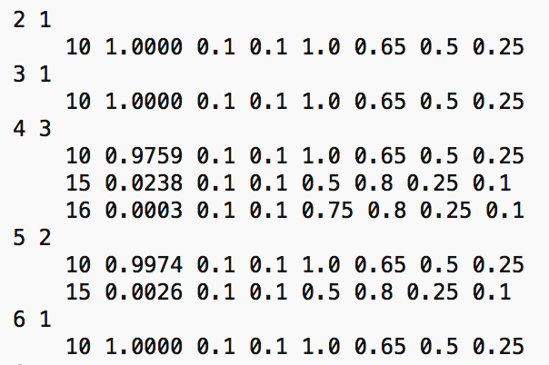
VEGETATION PARAMETER FILE
Defines land cover types present and fractional areas for a grid cell
Also define rooting depths and rooting distributions for each land cover type
Optional parameter setting:
Blowing snow
LAI
Vegetation cover
Albedo
Vegetation parameter file documentation: http://vic.readthedocs.io/en/master/Documentation/Drivers/Classic/VegParam/
Grid cell ID
Number of vegetation classes
Vegetation class
Fractional cover
Rooting depths
Root distribution

Slide 7
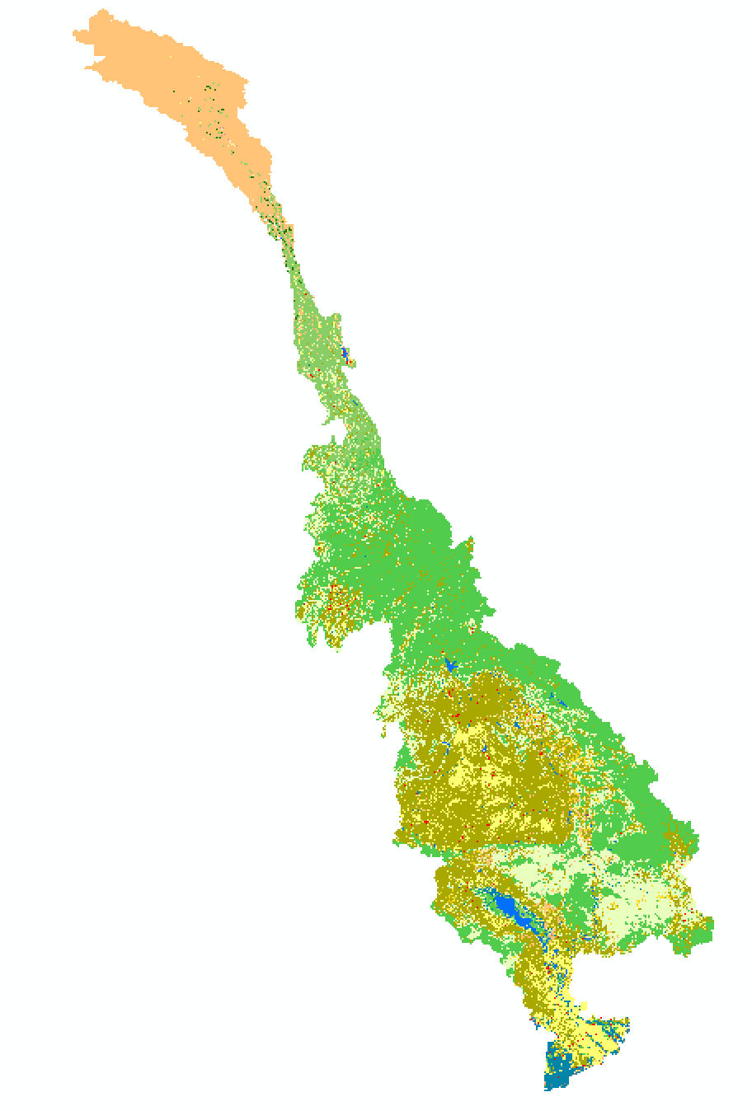
LAND COVER DATA AND PARAMETERIZATION
Can use whichever land cover dataset/classification best fits your needs
Create vegetation parameter file
Extract information for vegetation library
MODIS Combined Land Cover Product (MCD12Q1) IGBP classification
Fairly accurate mapping at global scale
Existing land cover parameterizations for land surface models
https://lpdaac.usgs.gov/dataset_discovery/modis/modis_products_table/mcd12q1
Create your own land surface parameterization scheme or use existing
NCAR NOAH LSM parameterizations
http://www.ral.ucar.edu/research/land/technology/noahmp/HRLDAS-v3.6/VEGPARM.TBL

Slide 8
VEGETATION LIBRARY FILE
Defines land parameterization for model
Parameterization provided for each possible land cover class
Library file referenced by vegetation parameter file
Vegetation library file documentation: http://vic.readthedocs.io/en/master/Documentation/Drivers/Classic/VegLib/

Slide 9
LAND SURFACE PARAMETERIZATION
Use observed remote sensing datasets to create your own land surface parameterizations
Need monthly climatology information for albedo and LAI parameters
MODIS LAI and albedo products (2000-present)
LAI: https://lpdaac.usgs.gov/dataset_discovery/modis/modis_products_table/mod15a2
Albedo: http://modis-atmos.gsfc.nasa.gov/ALBEDO/index.html
Can use remote sensing datasets for vegetation height, surface roughness, etc.
Large errors with derived data
Can lead to errors in model
Should you use observed remote sensing data or existing parameterization?

Slide 10
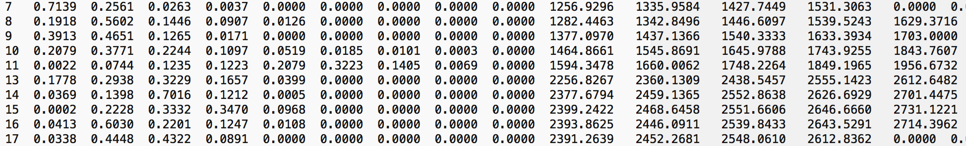
ELEVATION BAND FILE
Not a required input
Used to partition grid cell into different elevation for more accurate orographic effects
Set maximum number of elevation band
Each grid needs the maximum number of bands specified (fill non-existant bands with zeros)
Elevation band file documentation: http://vic.readthedocs.io/en/master/Documentation/Drivers/Classic/SnowBand/
Grid cell ID
Band percent coverage
Average band elevation

Slide 11
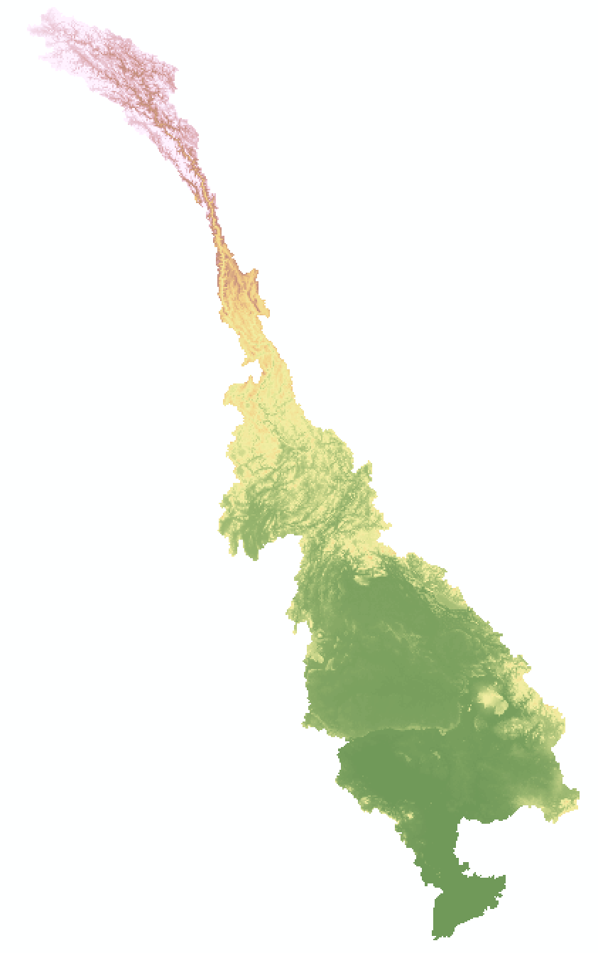
ELEVATION DATASETS
Plethora of DEM datasets available
SRTM, GMTED, HydroSheds, NED, etc.
http://www2.jpl.nasa.gov/srtm/
https://lta.cr.usgs.gov/GMTED2010
http://www.hydrosheds.org/
https://lta.cr.usgs.gov/NED
STRM has relatively high accuracy, but also relatively high spatial resolution compared to model resolution
Trade-offs between resolution and accuracy
Elevation data used to:
Create snow bands file
Prepare routing model inputs
Parameterize soils inputs

Slide 12
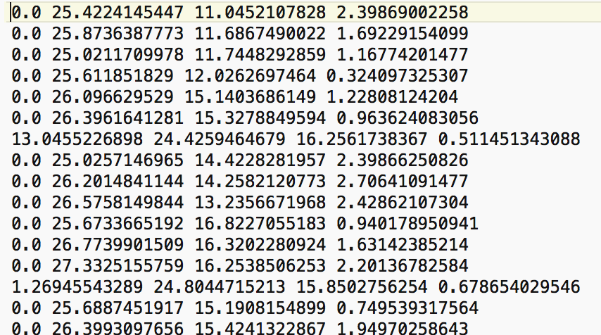
METEOROLOGICAL FORCING
VIC requires four meteorological variable inputs as a time series for each grid cell:
Daily maximum temperature (°C)
Daily minimum temperature (°C)
Surface wind speed (m/s)
Precipitation (mm)
Other meteorological inputs are supported:
Sub-daily temperature(°C)
Surface albedo (fraction)
Atmospheric density (kg/m³)
Downward short and longwave radiation (W/m²)
etc.
Sub-daily meteorological data is needed for energy balance equations!

Slide 13
METEOROLOGICAL FORCING (2 of 2)
Meteorological forcing data is used to drive the model processes
High degree of accuracy is needed for these datasets, otherwise model will not capture correct conditions
Meteorological forcing input data needs to be mapped to model grid cells
Need to interpolate station data
Global datasets
Temperature
ERA-Interim, http://www.ecmwf.int/en/research/climate-reanalysis/era-interim
MERRA-2, https://gmao.gsfc.nasa.gov/reanalysis/MERRA-2/
CSFR, https://www.ncdc.noaa.gov/data-access/model-data/model-datasets/climate-forecast-system-version2-cfsv2#CFS
Princeton dataset, http://hydrology.princeton.edu/data.pgf.php
Reanalysis
Precipitation
Next slide…

Slide 14
METEOROLOGICAL FORCING (1 of 2)
Global datasets (continued)
Precipitation:
CHIRPS, http://chg.geog.ucsb.edu/data/chirps/
IMERG, https://disc.gsfc.nasa.gov/datareleases/imerg_data_release
CMORPH, http://www.cpc.ncep.noaa.gov/products/janowiak/cmorph_description.html
GPCC, https://www.esrl.noaa.gov/psd/data/gridded/data.gpcc.html
Reanalysis
Wind: Reanalysis
Station data:
GSOD, https://data.noaa.gov/dataset/global-surface-summary-of-the-day-gsod
GHCN, https://www.ncdc.noaa.gov/data-access/land-based-station-data/land-based-datasets/global-historical-climatology-network-ghcn
Typically lack spatial resolution but have required variables and temporal resolution

Slide 15
VIC MODELING OPTIONS
VIC supports a wide variety of modeling applications
Open source nature of model development
You can contribute!
Can specify which model modes/components you would like to use for your own applications
For example: Water balance mode vs full energy balance mode
Most often needs additional data inputs
Example: http://hydro.washington.edu/forecast/monitor_west/

Slide 16
SPATIAL DISTRIBUTION OF PRECIPITATION
Distributes precipitation throughout grid cell as a function of rain intensity
Can account for orographic effects with small scale precipitation
Parameterize using climatology
Fractional coverage is based on exponential relationship
Soil moisture is averaged for grid cell before a new storm occurs
Spatially distributing rain is parameterized within the snow bands file

Slide 17
FROZEN SOIL SIMULATIONS
Important component in cold regions (high elevations or high latitudes)
Frozen soils can impede the infiltration of water content
Can alter spring soil moisture content and timing of streamflow
Has impact of the energy balance
Energy balance is solved at each node within the soil and iterated for convergence
Image from Open Access VIC Documentation: http://vic.readthedocs.io/en/master/Overview/ModelOverview/

Slide 18
LAKE AND WETLAND MODEL
Solves lake energy balance at different layers
Incorporates lake ice coverage, more realistic representation of surface processed over lakes
Takes into account water in/outflow
Assumes ”one” lake per grid cell
Wetland model allows for season inundation of wetlands
Better models the inter-annual water balance for wetland areas
Channel/soil recharge depending on flux demand
Image from Open Access VIC Documentation: http://vic.readthedocs.io/en/master/Overview/ModelOverview/

Slide 19
CARBON CYCLE MODEL
Allows for the simulation of vegetation photosynthesis and respiration
Plant phenology is not dynamic
Based on land surface parameterization (monthly LAI climatology)
Vegetative biomass is not simulated
Total carbon storage in plants
Calculates yearly Net Primary Productivity (NPP) based on vegetation type and meteorological conditions

Slide 20
HYDROLOGIC STATE FILES
Users can save last model conditions (specifically soil moisture conditions) to file
Important if using the model for hydrologic forecasts
Minimum model spin-up time is 1 year
Saves computation time
Model outputs are not consistent when using state files
Small differences in soil moisture results between using and not using a state file

Slide 21
THANK YOU
Kel Markert
kel.markert@nasa.gov

